Slide 1
Shopping cart
A Simple CRUD Micro Service Project
Enoch Abiodun (G00380316)

Slide 2
Initial Ideas and aspirations
To Have one other class other than Shopping Cart called “Item” and also another class “LineItem”
Item would have variables such as name and price
LineItem would have variables such as quantity and Id
For a Pipeline my first choice was going to be Jenkins and my plan was to run that in a Docker Container on a localhost that would be able to run by cloning the Repository from Github

Slide 3
So what was actually done…?

Slide 4

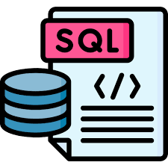









Applications and languages
Languages
Java (openJDK 17)
YAML
SQL
Applications
Spring (Initializer, Web, Boot-JPA)
Intellij IDEA 2023.2
Github & GitLab (Repository)
Gitlab Runner (Pipeline)
Docker
PostgreSQL
Jira

Slide 5
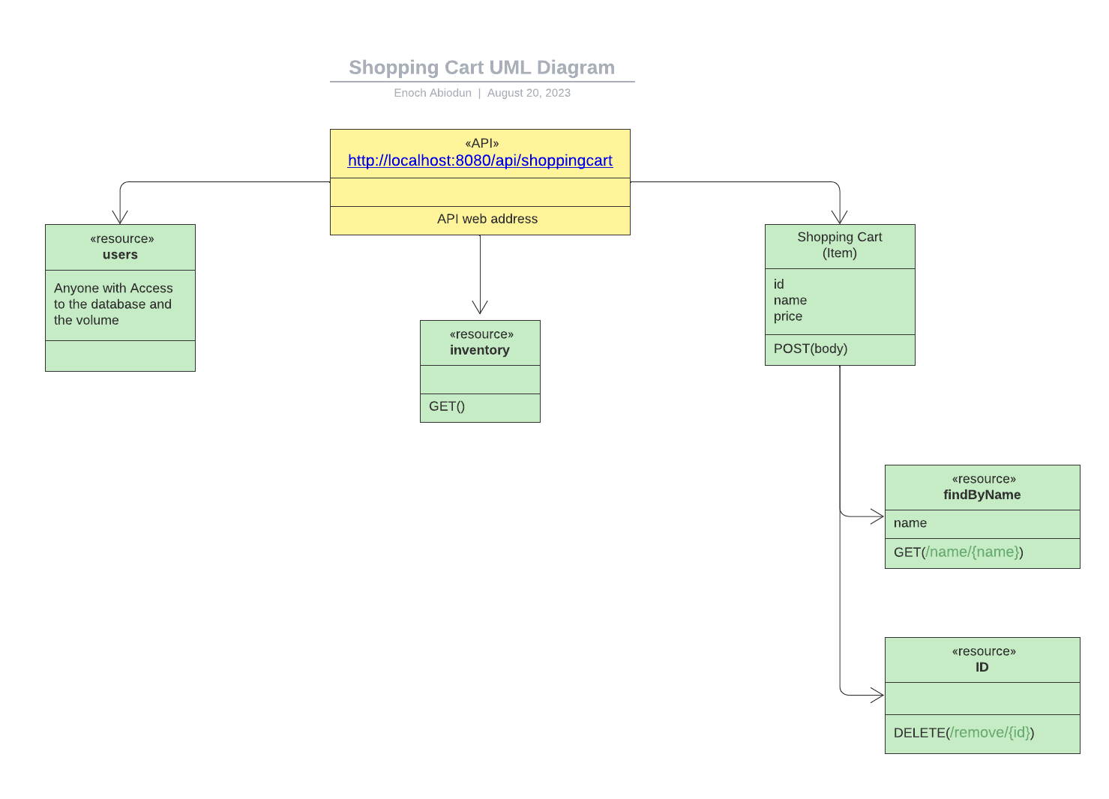
A Basic Uml diagram

Slide 6
Project management
Jira Software was the Project Management tool I decided to use
WHY?
Well I have previous experience using Jira when I worked for Fidelity Ireland in an Agile Environment and I seen a lot of the benefits it has to offer in terms of work efficiency and breaking down large projects
Jira has many integration options such as linking your repository and making confluence pages which are like word.doc describing a certain feature that was created by a issue(Task) you completed
Jira automatically generates reports on how efficient you are with workload and encourages you to hit your deadlines you have set for a time period called “Sprints”
Ultimately it’s a free easy to use software and although I am working alone for this project you still feel like working with team members in a Scrum Agile Environment like this project was intended to be a Group Project with people having a separate tasks but one goal

Slide 7
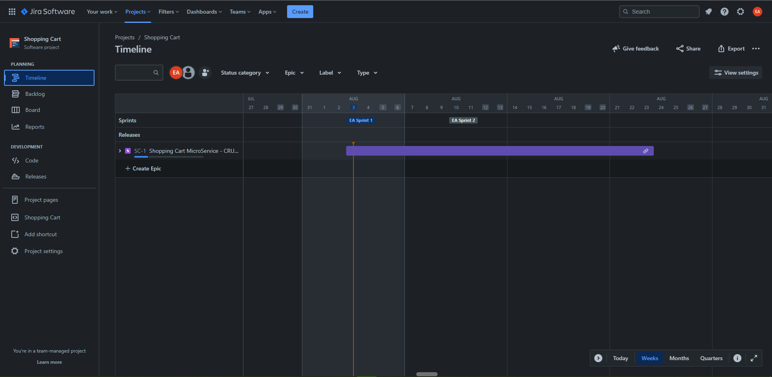

Slide 8
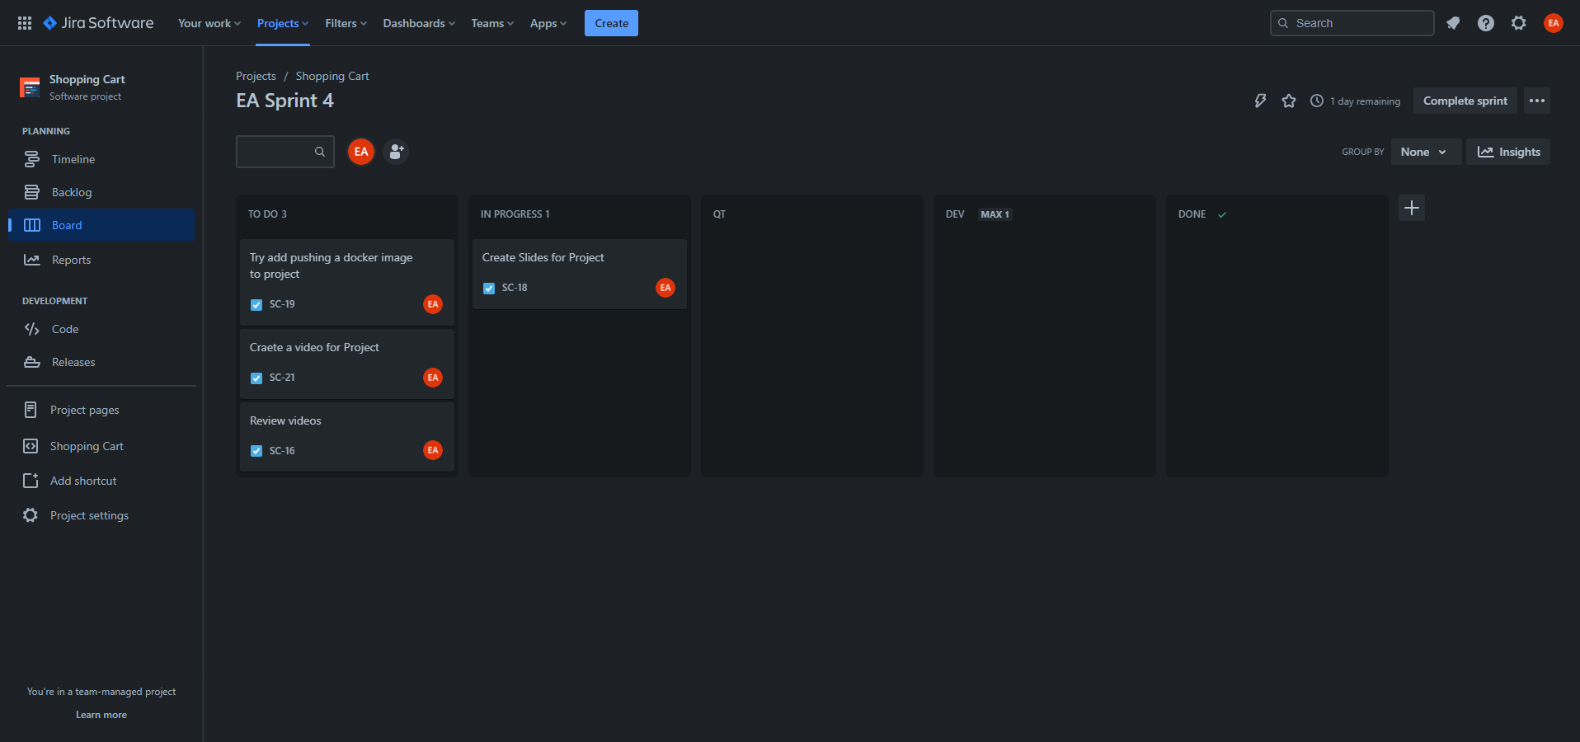

Slide 9
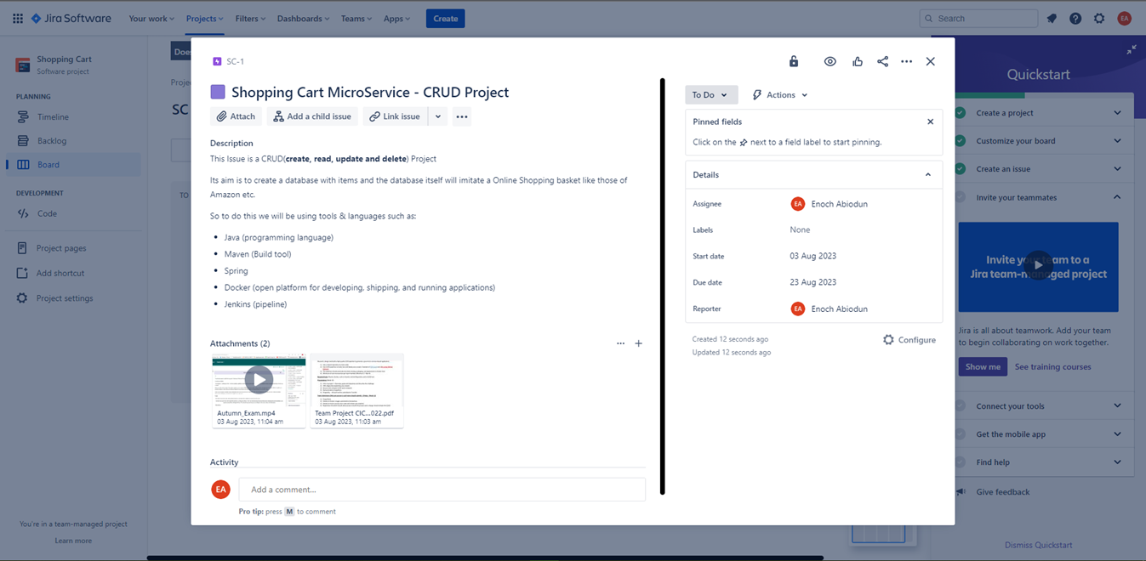

Slide 10
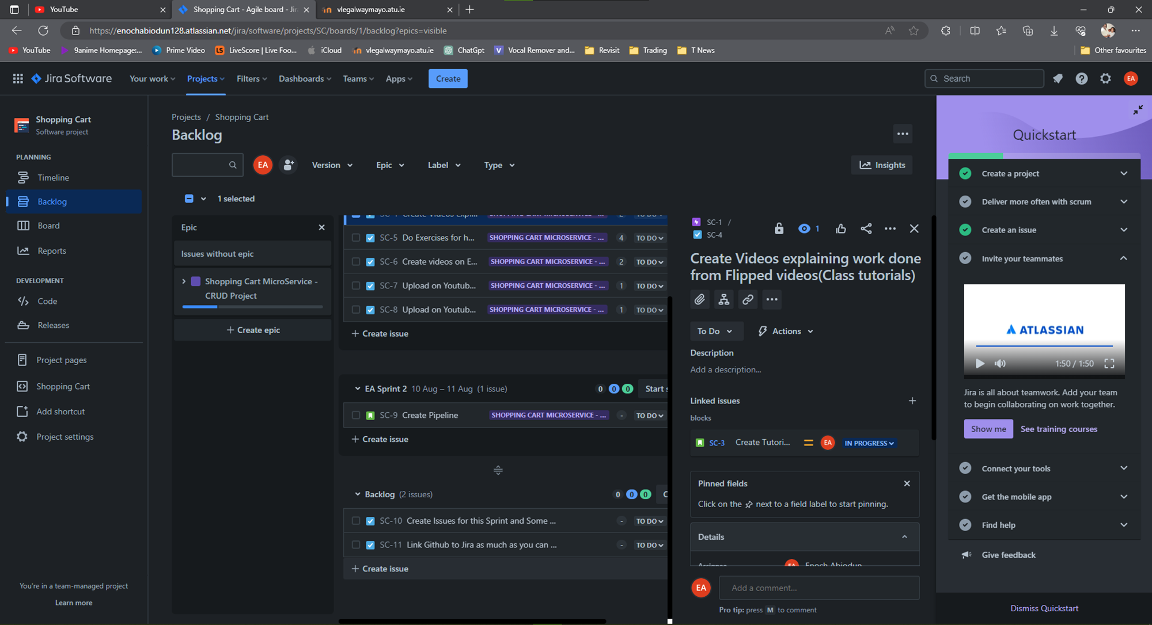

Slide 11
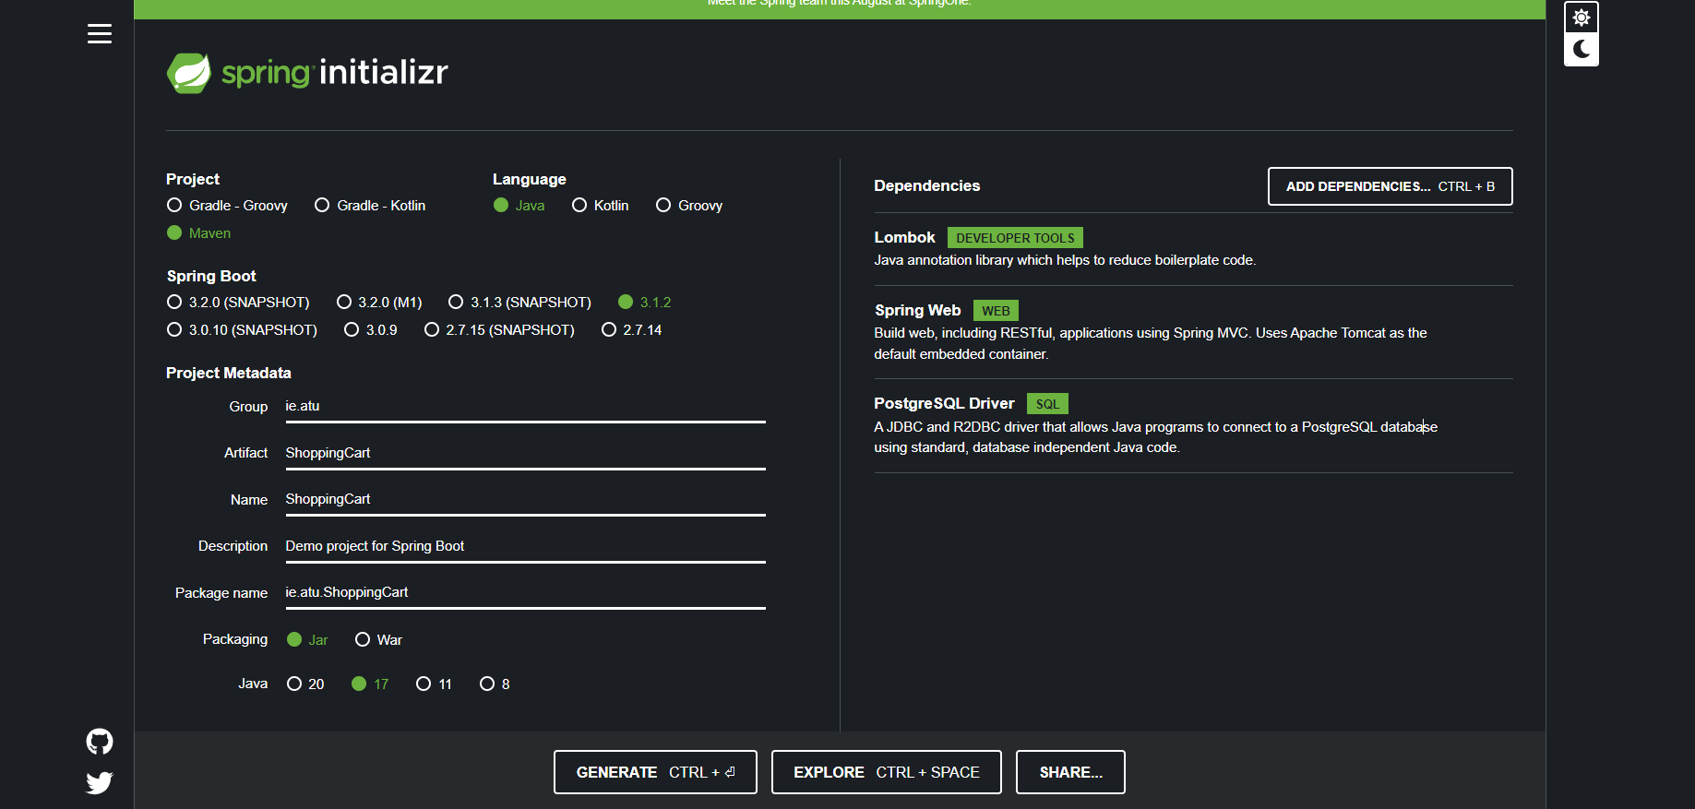
Spring Initializer
Using Spring Initializer to start up a quick project

Slide 12
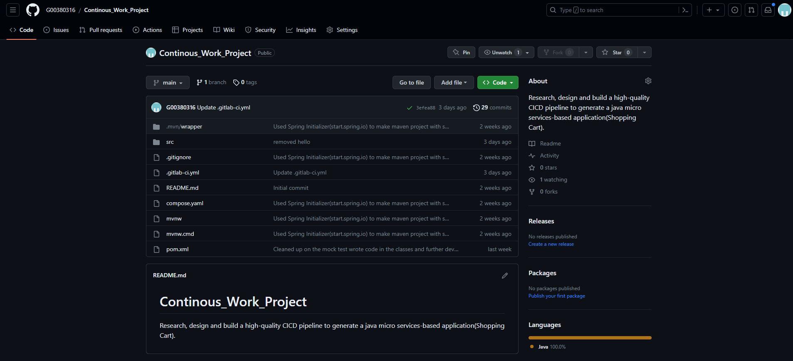
Repository(github & GitLab)
So for our Repository where we are going to be storing code initially I was going to use Github and I was actually using Github for some time but at the time of Pipeline Configuration decided to switch to GitLab.

Slide 13
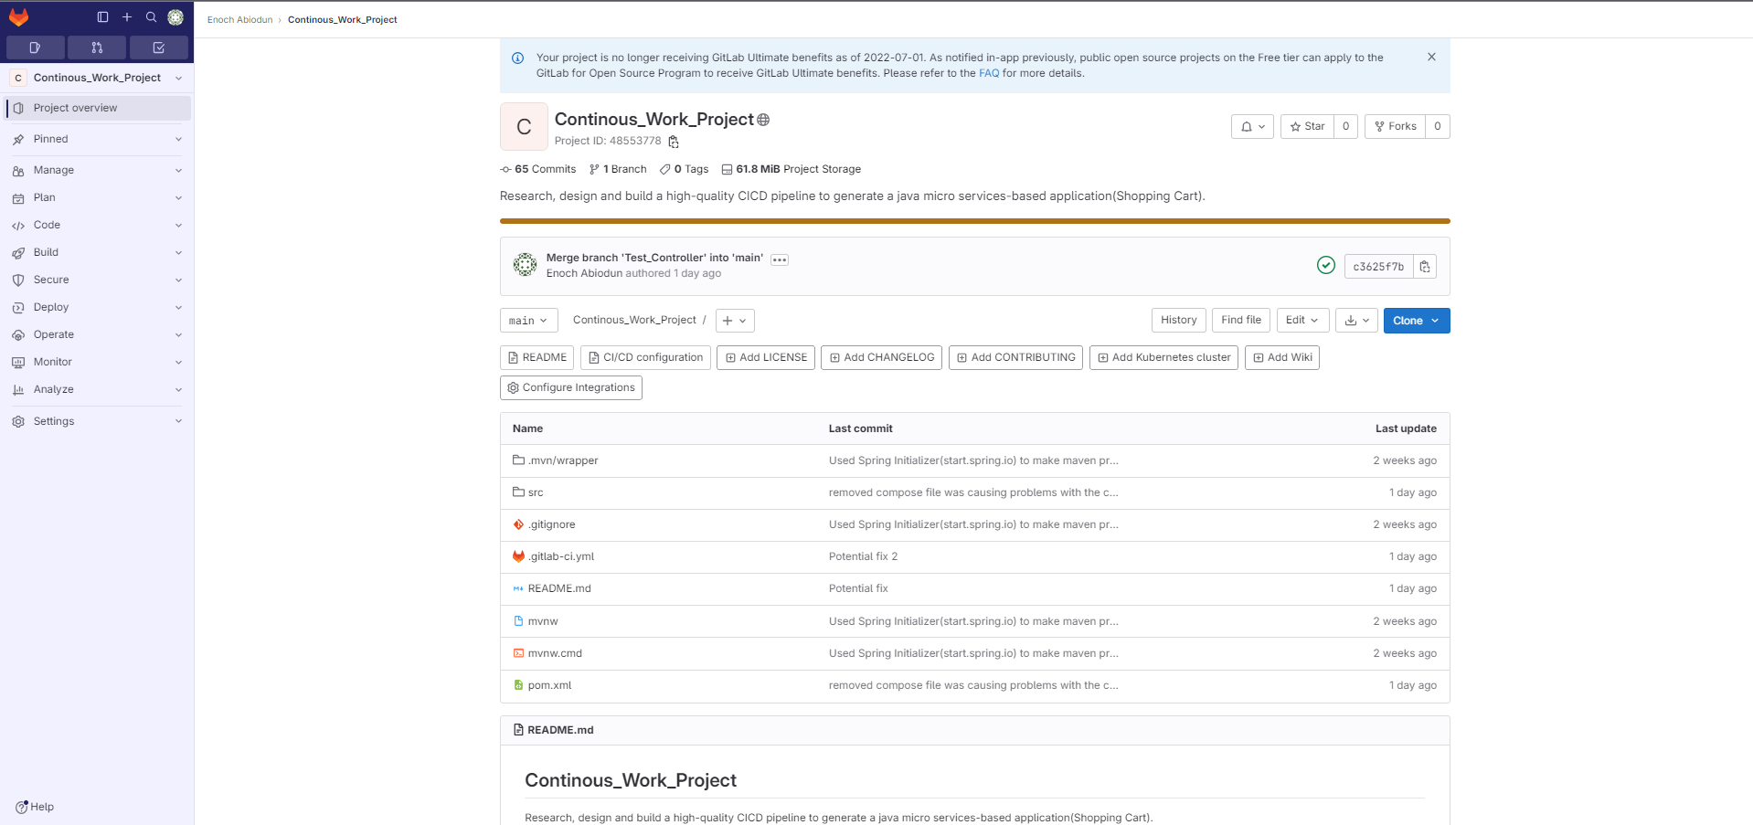
Repository(github & GitLab)
Links
Github - https://github.com/G00380316/Continous_Work_Project
GitLab - https://gitlab.com/G00380316/Continous_Work_Project

Slide 14
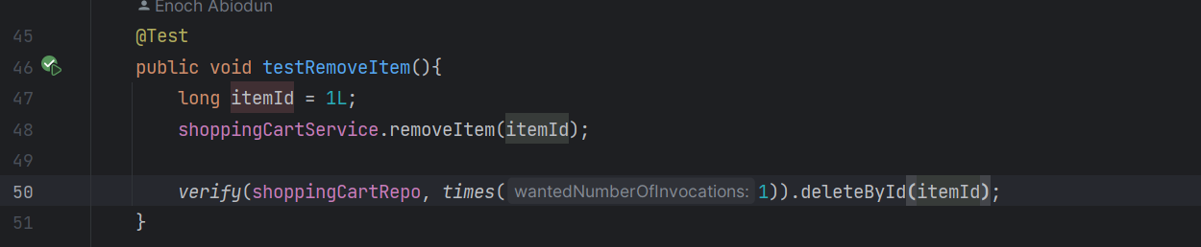
JUNIT Testing
In the Initial production of the code in this project we first looked at writing test methods
This helps get a scope of the actually methods we are going to use in our main classes
It helps develop highly reliable and bug-free code

Slide 15
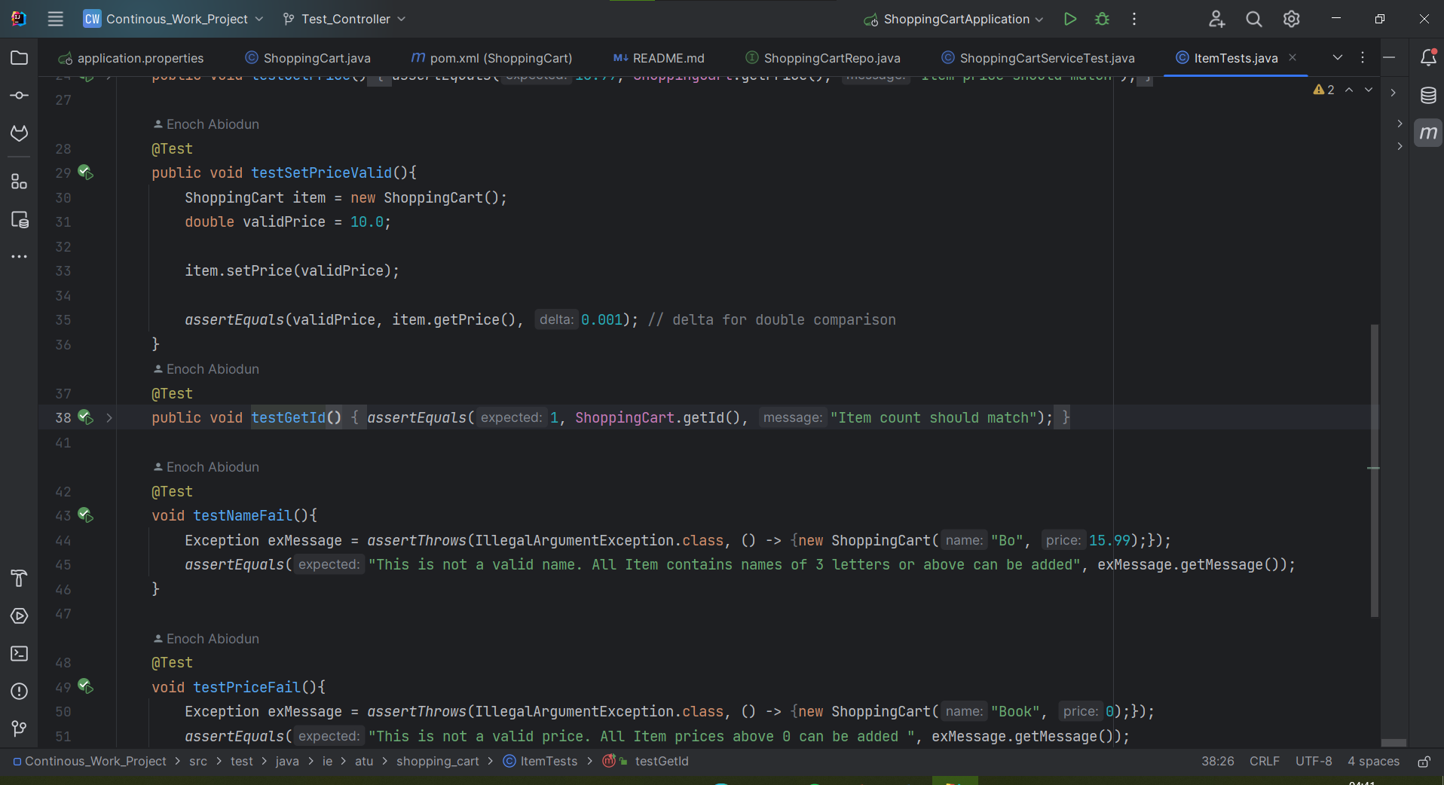
Test method Examples

Slide 16
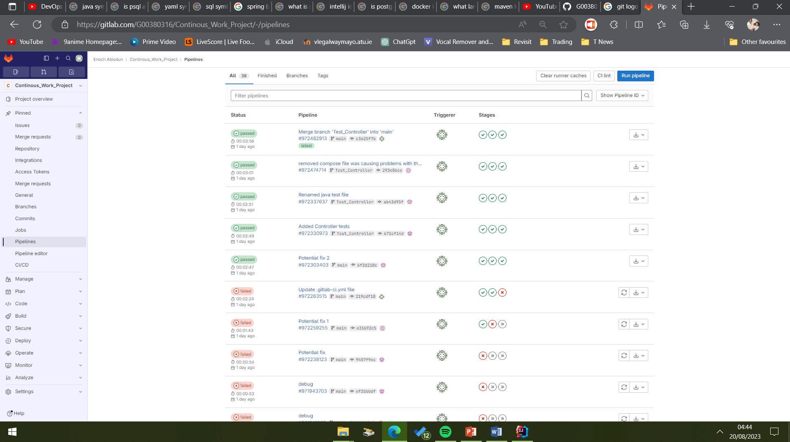
Pipeline – Gitlab runner
GitLab Runner is an application that works with GitLab CI/CD to run jobs in a pipeline
I chose this tool to manage my Pipeline for its automation and scalability and because of the GitLab ecosystem and having your repository and pipeline all in the one area
Also, the Pipeline Build file is a yaml file so I am familiar writing instructions for the Build file

Slide 17
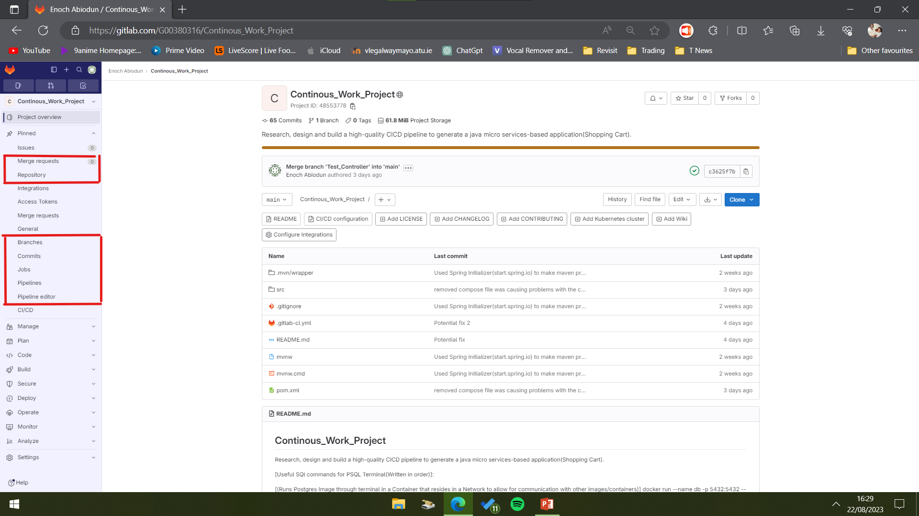
Example of gitlabs different features
The UX design of the page allows for swift transition to one Application to another in the GitLab ecosystem.

Slide 18
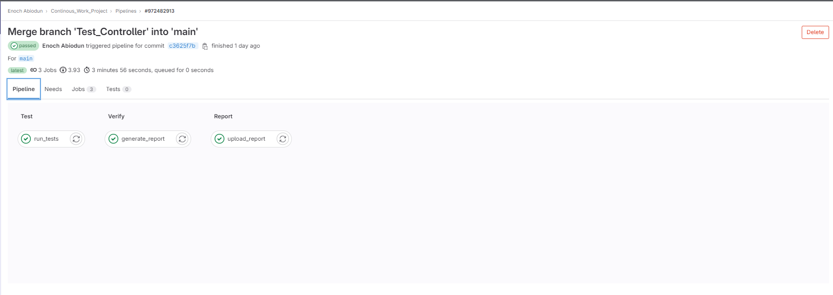
pipeline passed - example

Slide 19
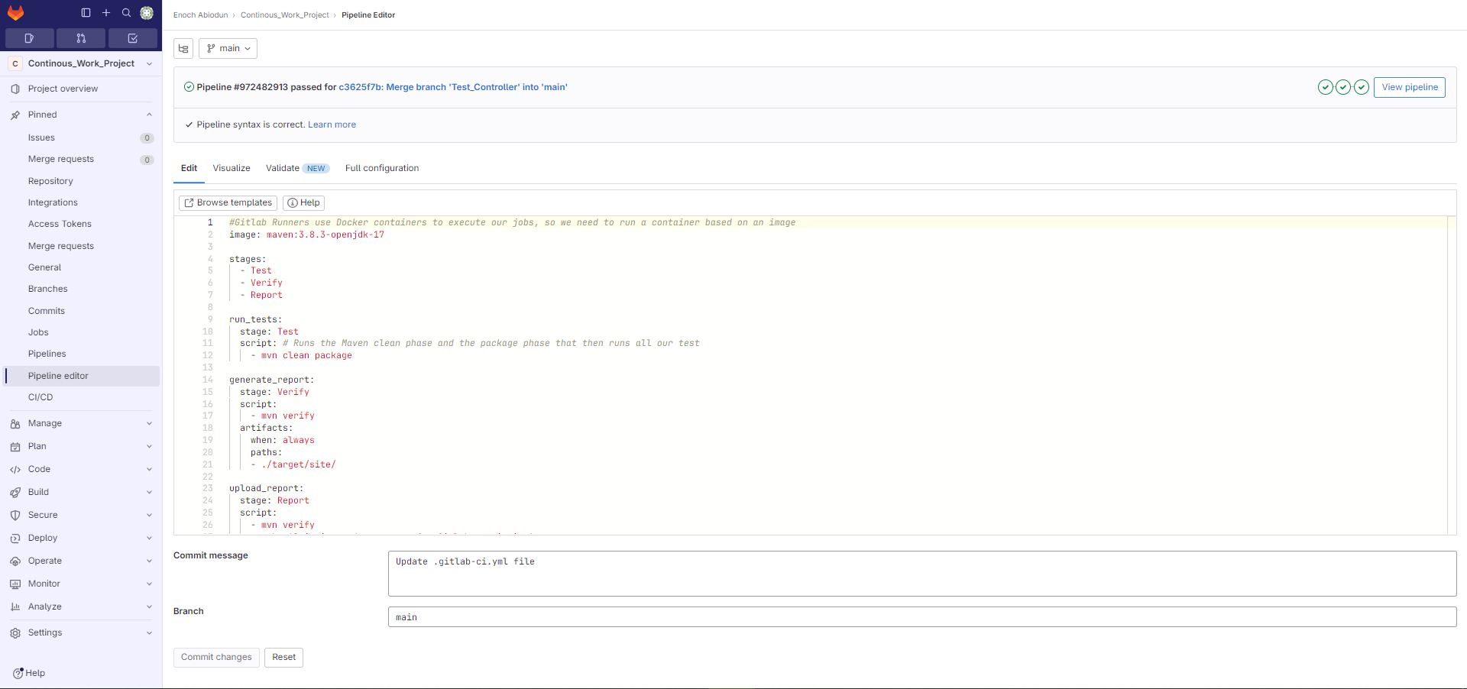
Pipeline yaml file
The Yaml file below for the pipeline with Stages listed out and some instructions…

Slide 20
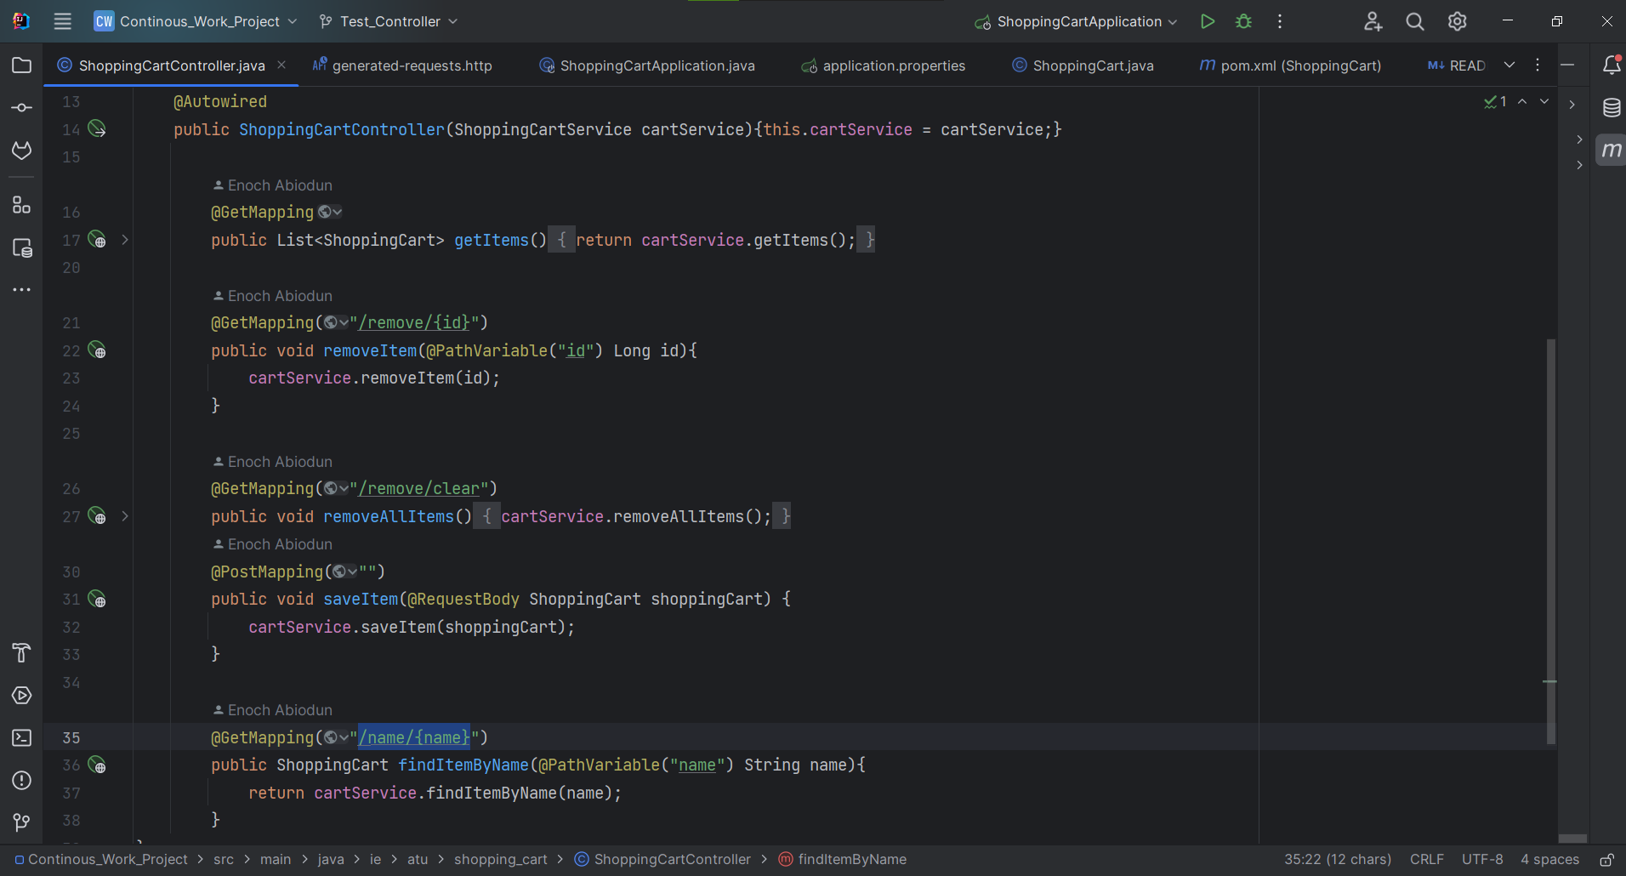
Shopping cart Controller code

Slide 21
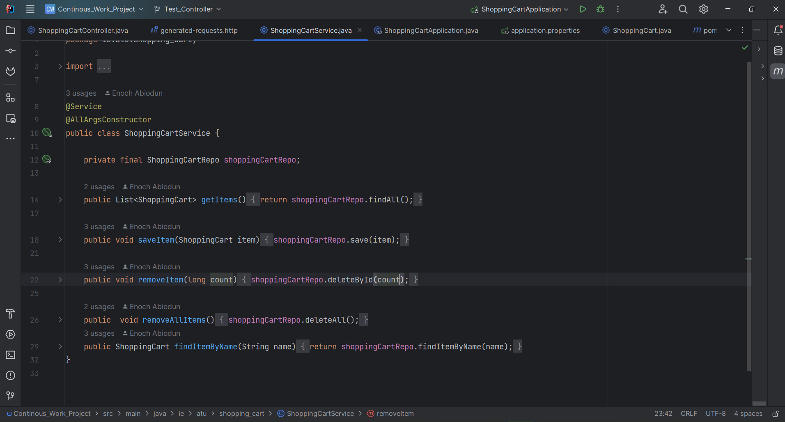
Shopping cart service code

Slide 22
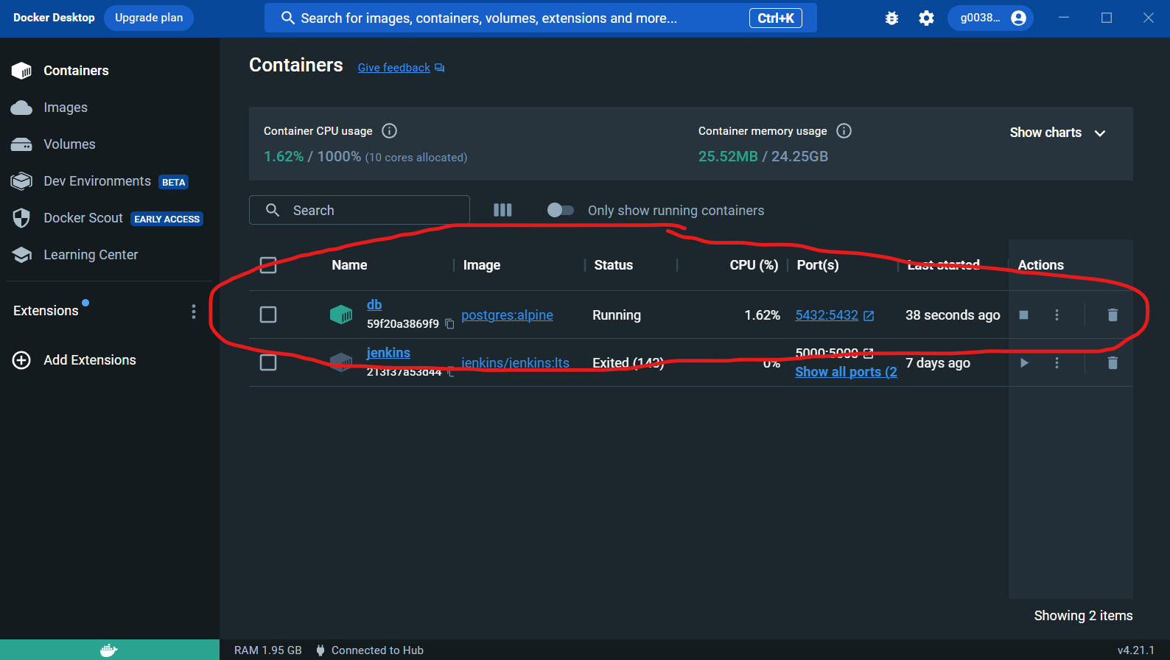
Docker Desktop - container
Container “db” is running and its connected to a network where we have postgres and psql terminal running and communicating to each other

Slide 23
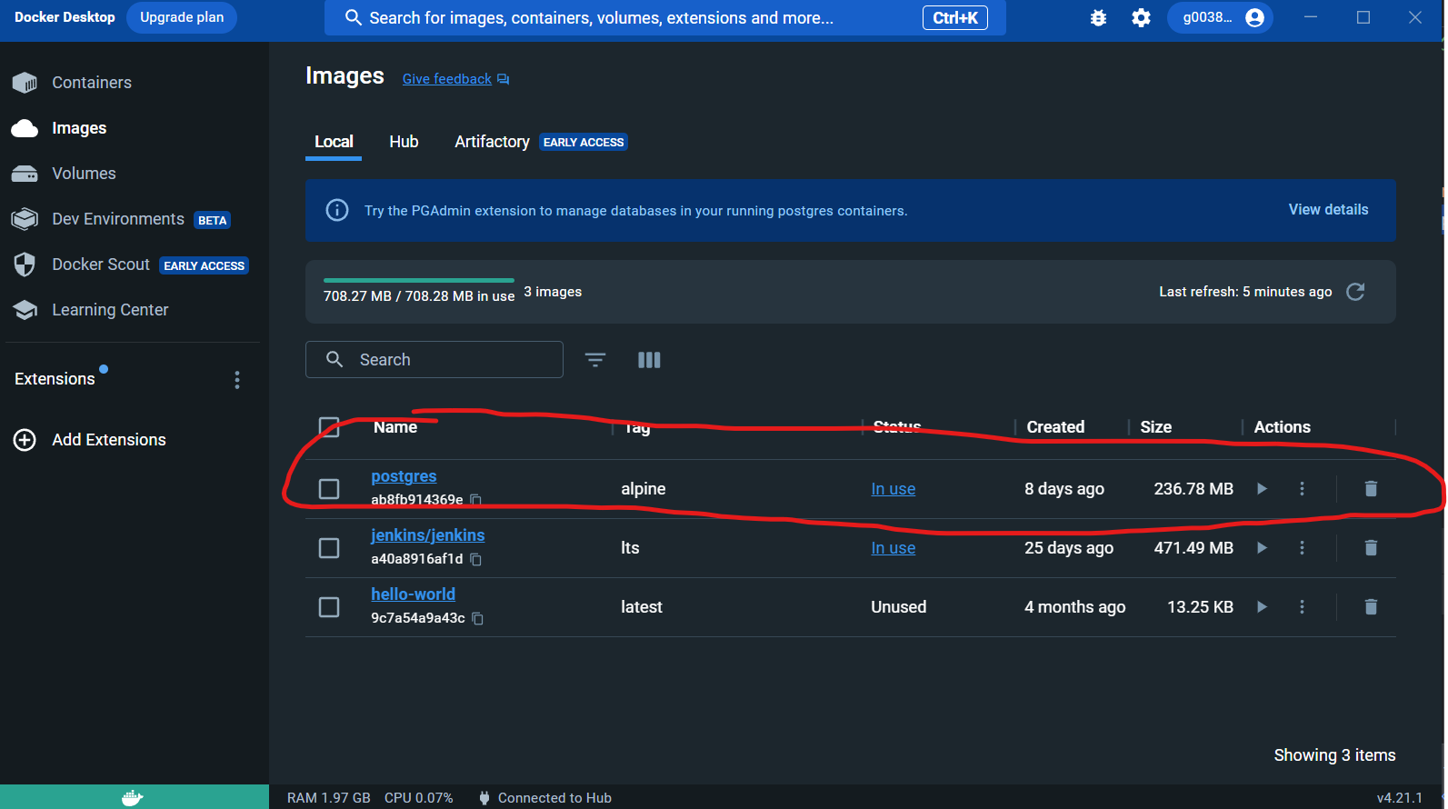
Docker Desktop - Image

Slide 24
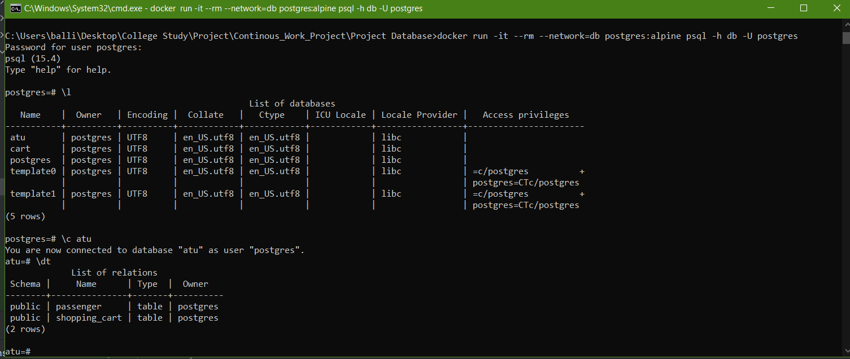
Psql terminal - example

Slide 25
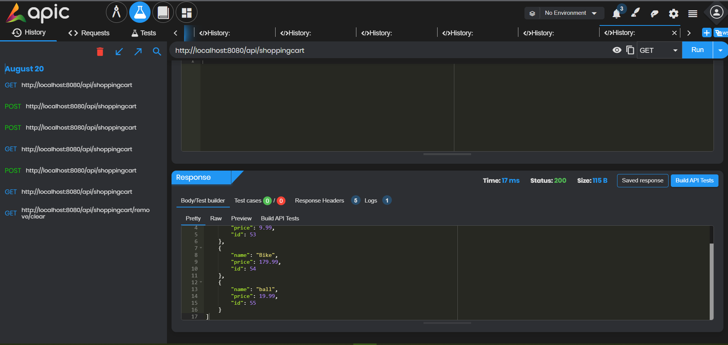
Generating http request – Get Example

Slide 26
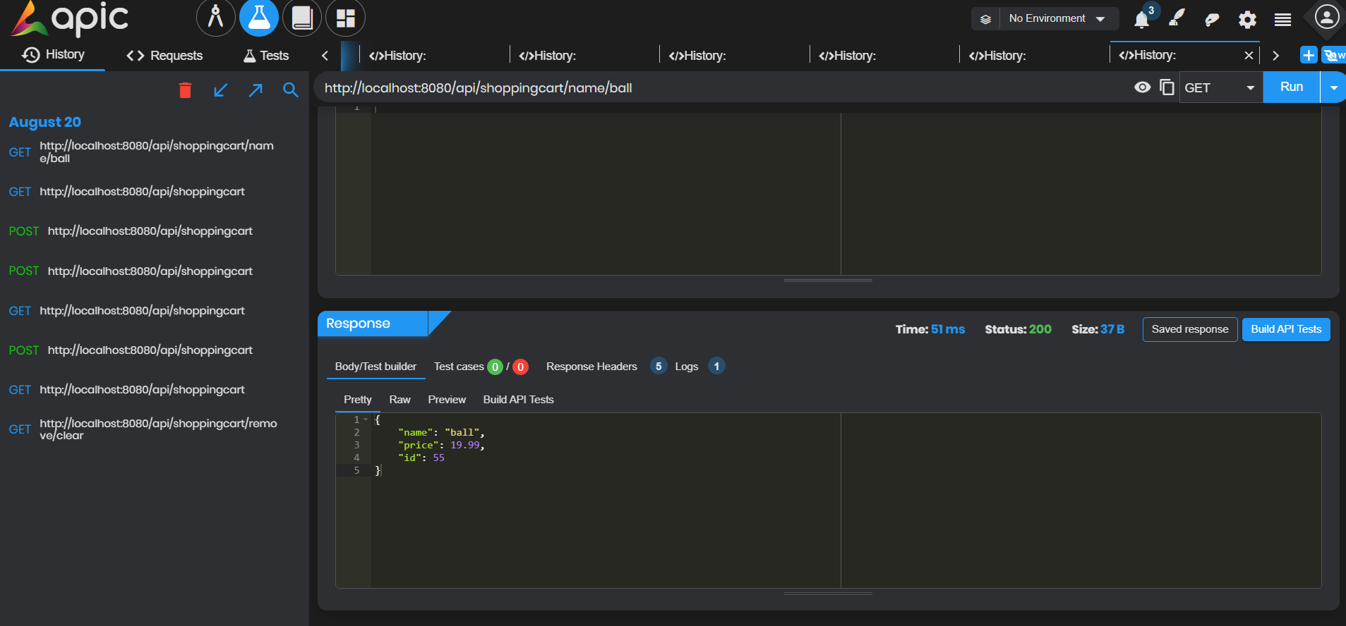
Generating http request – Get Example
In this slide we are using the information in the above slide to search our database for the Item in Shopping Cart with the name “ball”

Slide 27
Thank you for watching!!! Kind Regards Enoch Abiodun

